Slide 1




ARGENTINA 2002
Buenos Aires, November 26, 2002

Slide 2
By the end of 2001, the Argentine economy faced one of the worst crisis of its modern history.
We can summarize this with a chart:

Slide 3
What Happened ?
Peso Conversion
Default on Public Debt
“Corralito” (freezing
of bank deposits)
Devaluation
Argentina
2002
Inflation
Abandonment of
Convertibility
Freezing of Tariffs
(Public Utilities)
Exchange Controls
Expansion of Provincial
“quasi - currencies”

Slide 4



ARGENTINE REGULATIONS - evolution
Evolution of Laws, Decrees, BCRA Communications and Resolutions opf the Commerce Secretariat
TRIAL AND ERROR
UNCLEAR RULES
Devices for restricting flight of capital
shows
UNTIDINESS
UNCERTAINTIES
Function name

Slide 5
Public Emergency Law:
Evolution
Decree 1570/01 Restricts transfers abroad, except for those from Foreign Trade.
Decree 1606/01 Reestablishes the obligation of inflow of foreign currency
Resol. SC270/01 Establishes minimum payment terms
Resol. SC269/01 Establishes maximum term for the inflow of foreign currency

Slide 6
Main consequences of the Devaluation :
On Balance Sheets
- Peso receivables were diluted in dollar terms
- Government bonds defaulted
Assets - Private bonds defaulted
- Fixed Assets were diluted in dollar terms
- Tax losses carryfowards:exposed to dilution (inflation)
- Peso debts were diluted in dollar terms
Liabilities - Dollar debts (under Argentine Law):pesified + CER (Peso convertion)
- Dollar debts (under foreign law) :remain in dollar
  Valuation of assets
  Adjustment for inflation
  Negative net worth
PN

Slide 7
Main consequences of the Devaluation
On P&L
- Improved revenues in Pesos
Exports
- Most debts are in real dollars
- Lower volume of sales (recession)
Domestic
- Lower margins

Slide 8
  Every foreign currency transaction without intervention of an authorized entity
  Operate in the exchange market without authorization
  Untrue statement related to exchange transactions
  Omission to rectify statements or adjustments if the real transaction was different from the one being reported
  Operation made per quantity, currency, quotation or terms different to those established by the rules
  Every act or omission breaching exchange regulations
CRIMINAL
ISSUES

Slide 9
Fine = up to ten times the amount
Penalties
Prison from 1 to 4 years (1° relapse)
Prison from 1 to 8 years (2° relapse)
+ Suspension to operate in the exchange market (10 years)

Slide 10
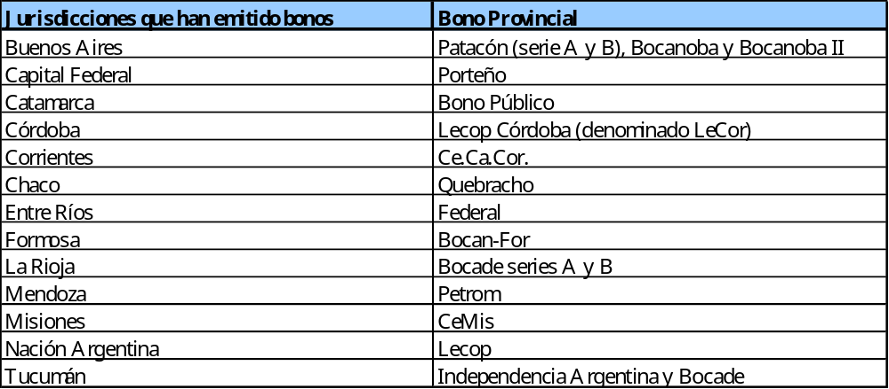
Currency destruction due to abundacy of means of payment
Treasury bonds operating as currency

Slide 11
Provincial Bonds
Aconcagua Neuquén
Becor San Juan
Río Negro Salteño
Bosafi Tucu2
Boso Tucu3
Cedepir Tucu5
Cemis
Form
Formosa

Slide 12
Municipal Bonds
Hurligham
Ituzaingo
J.C.Paz
Malvinas
Moron
Munitucu
Resistencia

